Slide 1
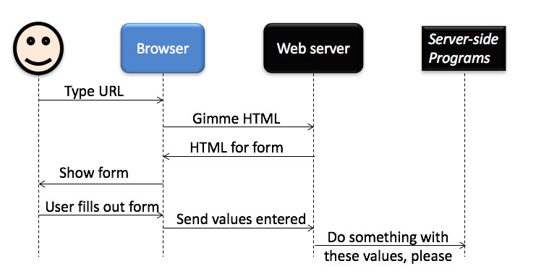
HTML Forms
HTML forms enable your web application to collect information from your users

Slide 2
HTML Forms
HTML Forms are one of the main points of interaction between a user and a web site or application. They allow users to send data to the web site. Most of the time that data is sent to the web server, but the web page can also intercept it to use it on its own.
An HTML Form is made of one or more widgets. Those widgets can be text fields (single line or multiline), select boxes, buttons, checkboxes, or radio buttons. Most of the time those widgets are paired with a label that describes their purpose — properly implemented labels are able to clearly instruct both sighted and blind users on what to enter into a form input.

Slide 3
Bare minimum for a form
<form action="http://web.engr.oregonstate.edu/~scaffidc/formrepeater.php" method="GET">
<input type="submit">
</form>
Very minimal, Has no input fields
Notes:
Before starting to code, it's always better to step back and take the time to think about your form. Designing a quick mockup will help you to define the right set of data you want to ask your user. From a user experience (UX) point of view, it's important to remember that the bigger your form, the more you risk losing users. Keep it simple and stay focused: ask only for that data you absolutely need. Designing forms is an important step when you are building a site or application.

Slide 4
<form>
This element formally defines a form.
It's a container element like a <div> or <p> element, but it also supports some specific attributes to configure the way the form behaves.
All of its attributes are optional but it's considered best practice to always set at least the action attribute and the method attribute.

Slide 5
<form>
The action attribute defines the location (URL) where the form's collected data should be sent when it is submitted.
The method attribute defines which HTTP method to send the data with (it can be "get" or "post").

Slide 6
Textbox fields
<form action=” " method="GET">
<input type="text" name="myfield">
<input type="submit">
</form>
When your user types a value and hits submit, the form sends the value of myfield to the server. Notice the value appears on the URL.

Slide 7
Event Objects – target property
Every Event object also has a type property specifying what kind of event was triggered, as a string (e.g. 'click' or 'mousedown').
Most Event objects also have a target property, which represents the specific DOM element on which the event was triggered: var button = document.querySelector('.button'); button.addEventListener('click', function (event) { event.target.style['background-color'] = 'red'; });

Slide 8
Target property
If an event handler is registered to an element with children, target will point to the specific child that triggered the event.
To access the element to which the handler was registered, you may use the currentTarget property.

Slide 9
Event propagation
Events bubble up from children to parents and then to ancestors.
e.g. a click on a button will bubble up and trigger an event on the button’s container, then on the button’s container’s container, and so forth, up through the window.
If ancestor elements have a handler registered for an event that occurs on a descendant element, the ancestor’s handler will be triggered after the handler(s) of its descendants.
In all of these handlers, event.target will always point to the same element, the lowest element in the DOM that triggered the event.
In each handler, event.currentTarget will always point to the element on which the handler was registered.

Slide 10
Event propagation
An event handler may call the stopPropagation() method on the event object to stop the event from continuing to bubble up: event.stopPropagation();

Slide 11
Default actions
Many DOM elements have default actions associated with them. For example, an <a> element’s default click action is to open the associated link.
In some situations, we will not want the default action to occur because we are assigning our own special action in an event listener. In these situations we can prevent the default action from occurring by calling event.preventDefault().

Slide 12
Default actions
For example, to prevent the default action from occurring when some link is clicked, we could do this: var someLink = document.querySelector('a.no-default'); someLink.addEventListener(function (event) { event.preventDefault(); // Do some special event handling for this link. });

Slide 13
Default actions
Eg:
<a class="no-default">Go to Google</a>
JS: someLink.addEventListener('click',function (event) {
event.preventDefault();
alert('Do you want to leave the site?');
});

